Slide 1
NMAM Institute of Technology Project Presentation on- Currency Scanning, Identification and Adding Under the guidance of: Dr. Jyothi Shetty
Presented by:
Mohammed Akzar A K
(4NM17CS106)
Pratheeksha A M
(4NM17CS130)
Risha S Karkera
(4NM17CS146)

Slide 2
Problem Statement
This project mainly aims at scanning the currency notes and detecting if they are real ones or fake
The output is in the form of voice message. The real notes are identified and total amount is counted
It also displays the count of each note.
This application can be built by using CNN Algorithm to train the model.
Android Application Development is used to provide user interface.

Slide 3
Project Outline
Analysis
Data collection
Deep learning
Application building

Slide 4
Currency denominations we have used are :
10 rupees note
20 rupees note
50 rupees note
100 rupees note
200 rupees note
500 rupees note
2000 rupees note
We have also used fake note class and images of random backgrounds for no note detected class

Slide 5
Extra Features
There are several applications that already exists for scanning and identifying currency notes
Extra features that we added to our application are :
1. Identifying fake note
2. Count total amount
3. Display count of each note
Made it very easy for visually impaired people to operate
Did not add any buttons, just swipes

Slide 6
Data Collected
We downloaded dataset from kaggle website and clicked few images by ourselves using 3 different smart phones.
Cleaned the data so that
- Note covers ¼th of the image
- Both sides of note is included
- Folded images of note
- Images with good lighting condition
- Some foreground object covering note, not more than
20% (like finger)

Slide 7
Result
Our aim was to generate around 350 to 400 images for each class to be used as train sets at the beginning.
Generated 1000 instances for each class using data augmentation.

Slide 8
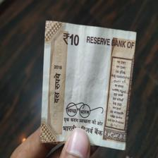
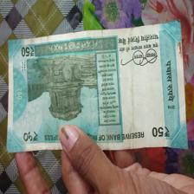
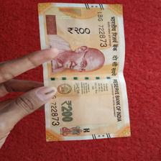
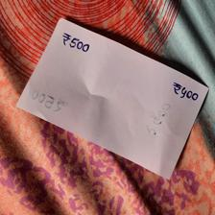
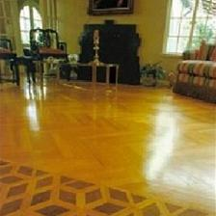
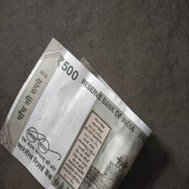
Sample images included in our dataset

Slide 9
Design and Implementation

Slide 10
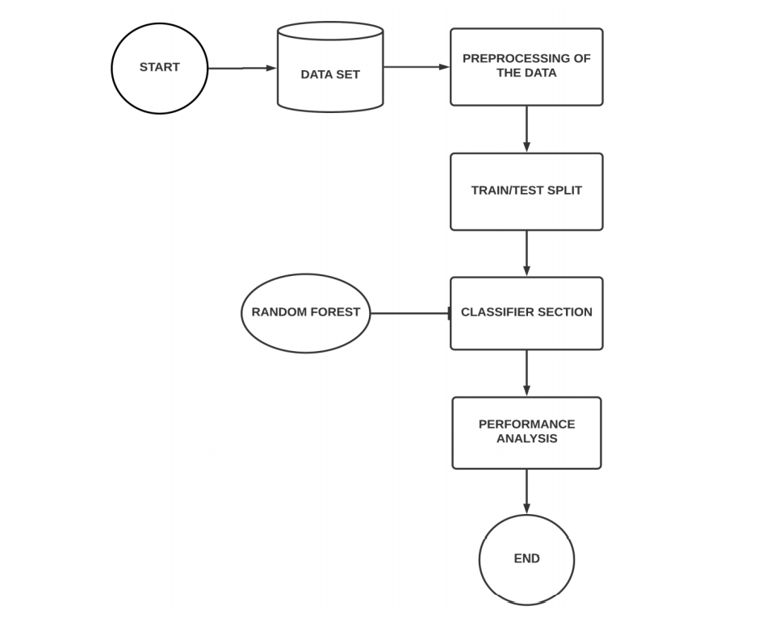
Methodology

Slide 11
Random Forest
Random forest consists of a large number of individual decision trees that operate as an ensemble.
Each individual tree in the random forest spits out a class prediction and the class with the most votes becomes our model’s prediction.
Instead of searching for the most important feature while splitting a node, it searches for the best feature among a random subset of features.

Slide 12
Convolution Neural Network
When running currency recognition app, the model needs to run locally on a smartphone
Must have low latency to deliver best user experience without sacrificing accuracy
We chose MobileNet architecture because it's fast enough on cell phones and provides decent performance

Slide 13

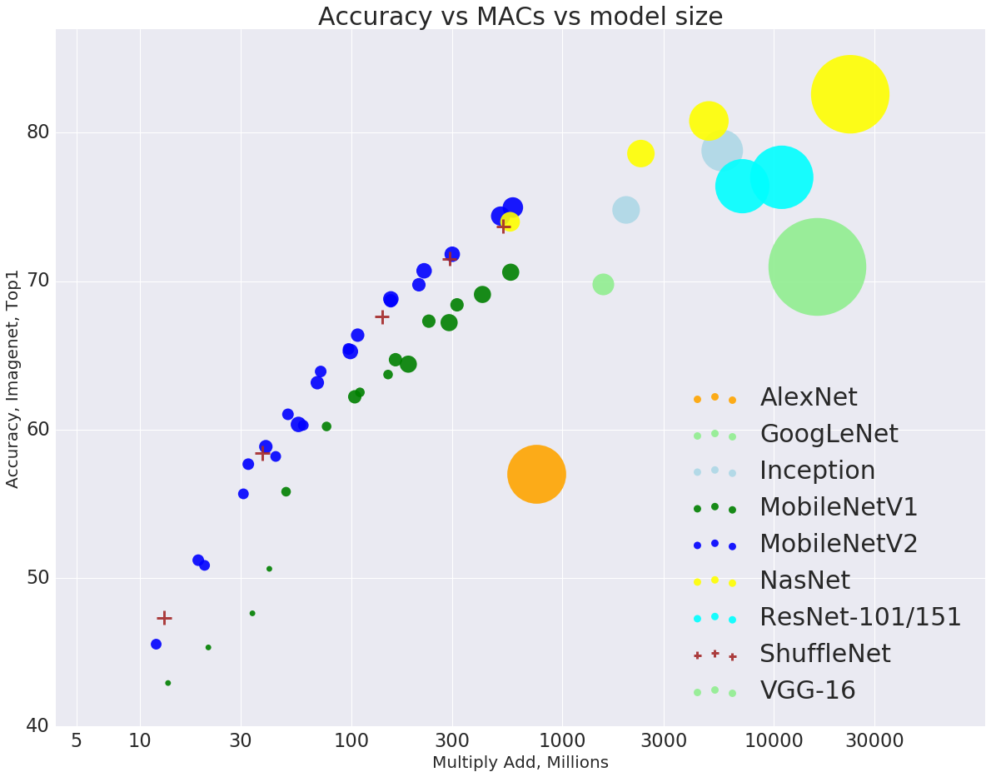
Convolution neural network
Accuracy of multiple CNN models

Slide 14
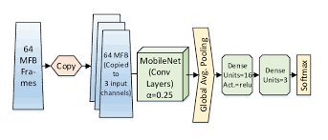
MobileNet V2 Architecture
Efficient and portable CNN architecture that is used in real world applications.
MobileNets primarily use depthwise separable convolutions
The size of the input image is 224 × 224 × 3.

Slide 15
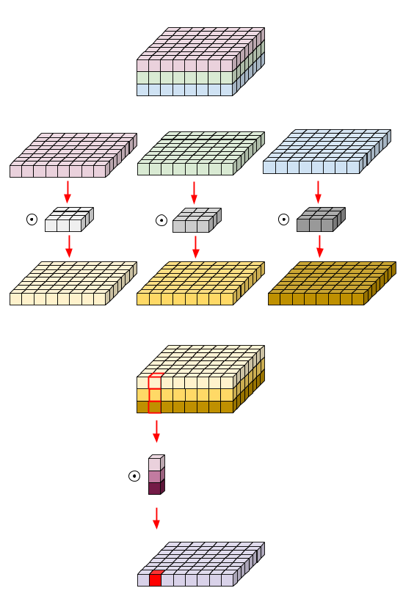
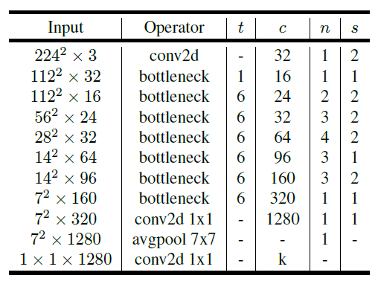
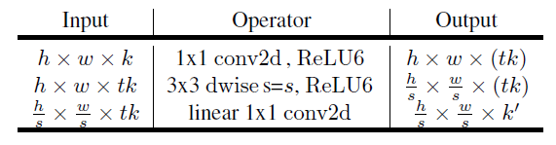
Depth-wise separable convolution
MobileNet v2 Architecture
t: expansion factor
c: number of output channels
n: repeating number
s: stride

Slide 16
Building and Training the Model
We chose to use two techniques for our small dataset:
Doing transfer learning with pre trained models on large datasets
Data augmentation technique

Slide 17
Transfer Learning
Transfer learning is a machine learning method where a model developed for a task is reused as the starting point for a model on a second task.
For Note Identification, since dataset is not large enough, starting with a pre trained model and further fine tuning the model can reduce training time and avoid possible over fitting
We have used Keras API in TensorFlow 2.0 for implementing MobileNet model on our dataset

Slide 18
Data Augmentation
Since we don't have enough input data, so reuse existing data as much as possible
For images, common techniques include – shifting the images, zooming in or out of the images, rotating the images, etc
This could be done using the Keras API of TensorFlow 2.0

Slide 19
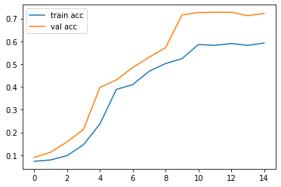
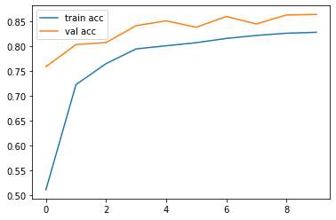
Accuracy Graph without Data Augmentation
Accuracy Graph with Data Augmentation

Slide 20
Training Result

Slide 21
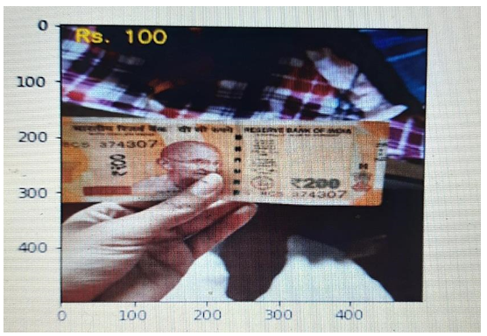
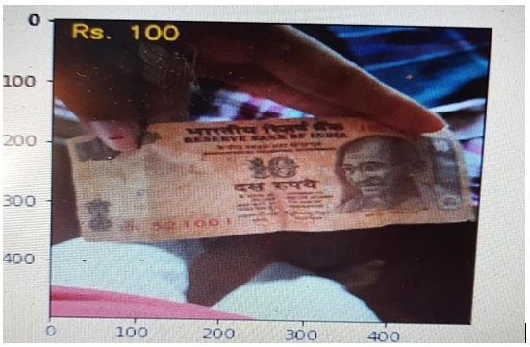
Random Forest

Slide 22
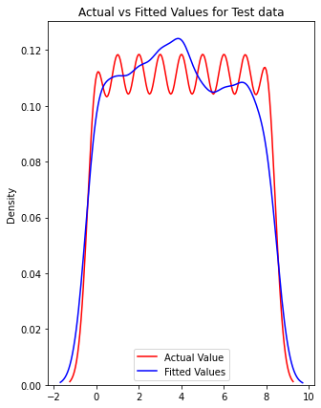
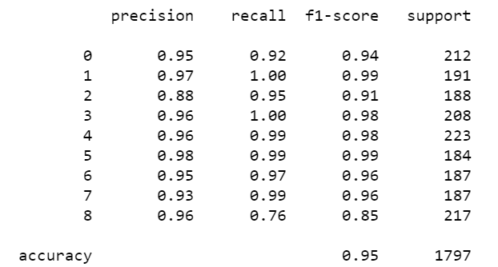
Graph for test data
Accuracy for test data

Slide 23
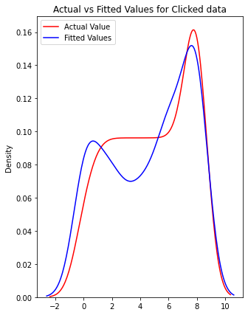
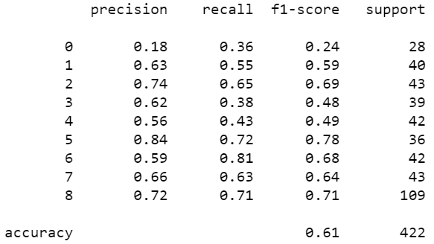
Graph for validation data
Accuracy for validation data

Slide 24
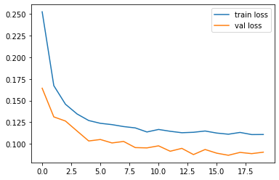
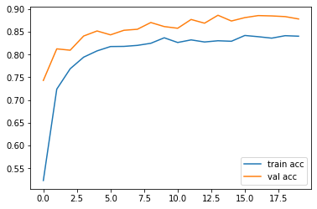
Convolutional Neural Network
Test data loss
Test data Accuracy

Slide 25
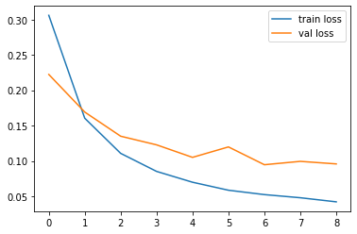
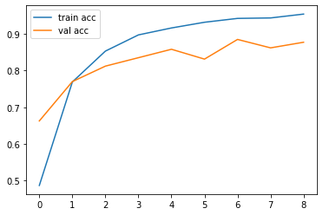
Validation data Accuracy
Validation data Loss

Slide 26
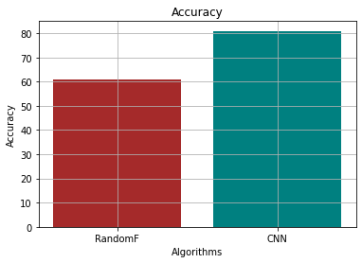
Comparing Random Forest and CNN Algorithms

Slide 27
Improving Accuracy
Used different datasets
Resized images to different pixels
Augmented data
Changed batch size
Changed epoch
Changed learning rate

Slide 28
Application Building
We want to run the app locally, so app can be used even when the internet connection is unavailable
We have used TensorFlow lite for image classification in our android app
Trained model is exported as a .tflite file
The output is in the form of voice message

Slide 29
Application Demo

Slide 30
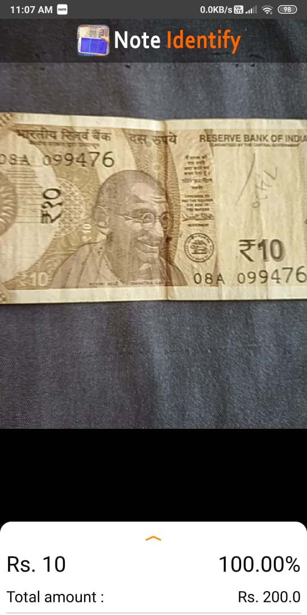
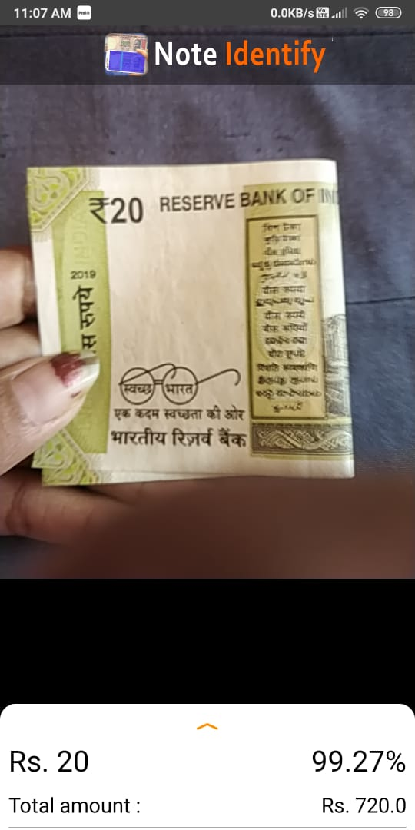
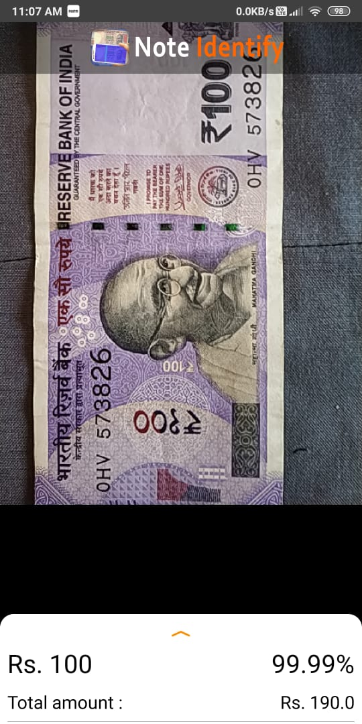

Slide 31
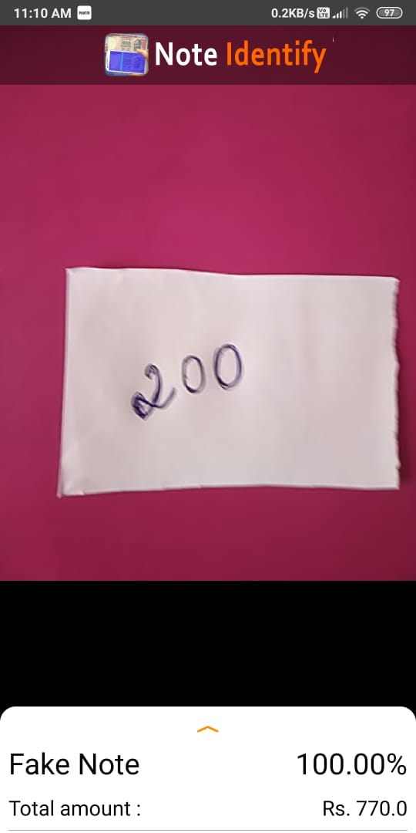
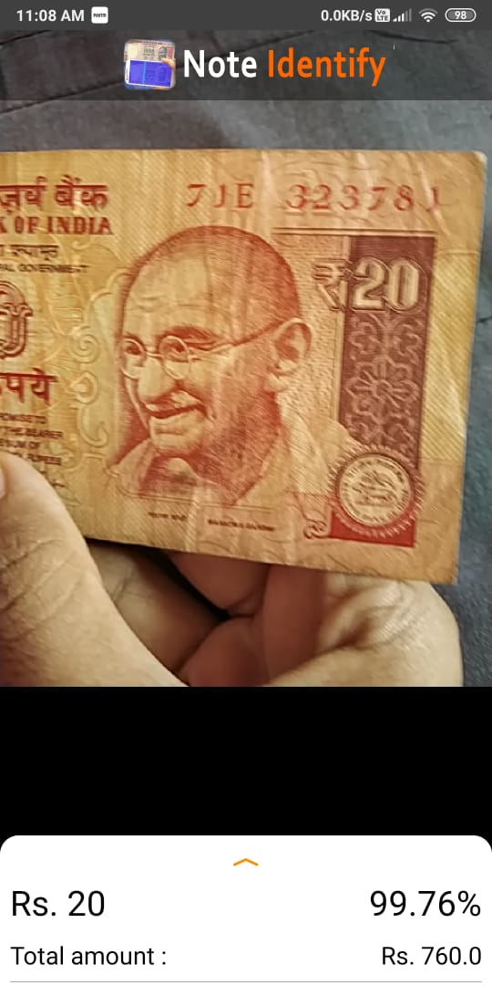
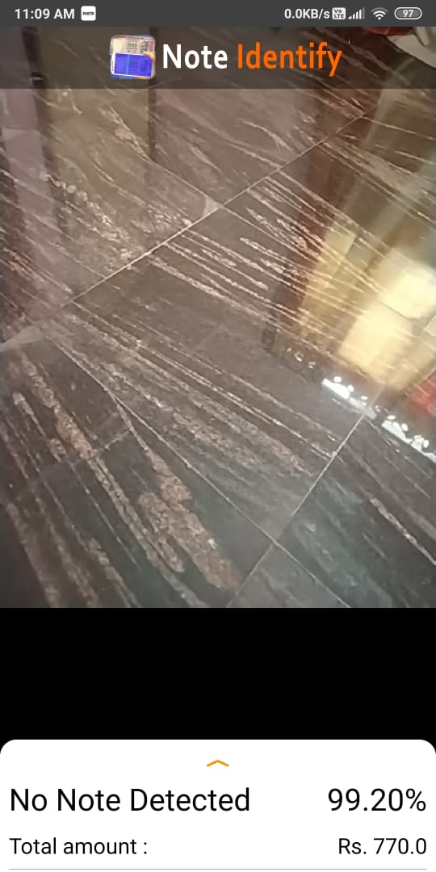

Slide 32
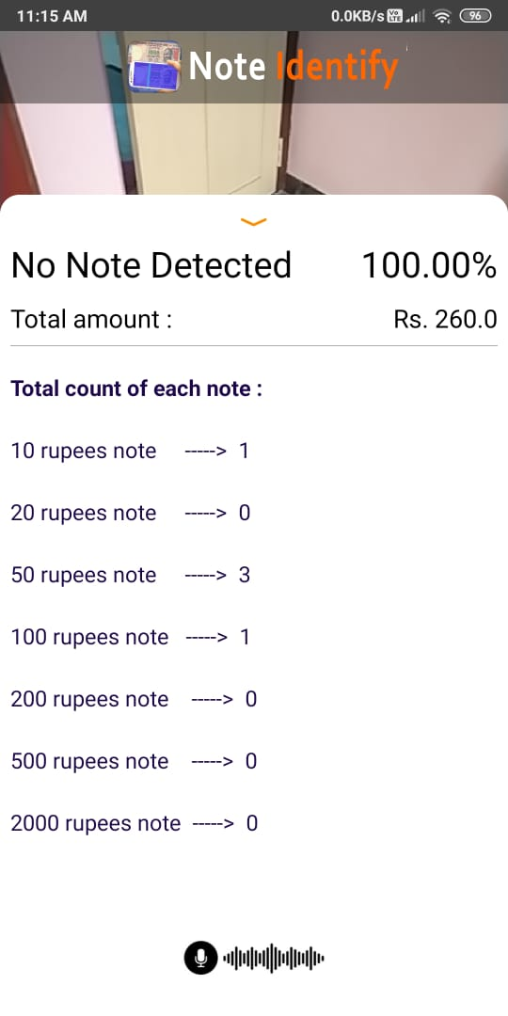
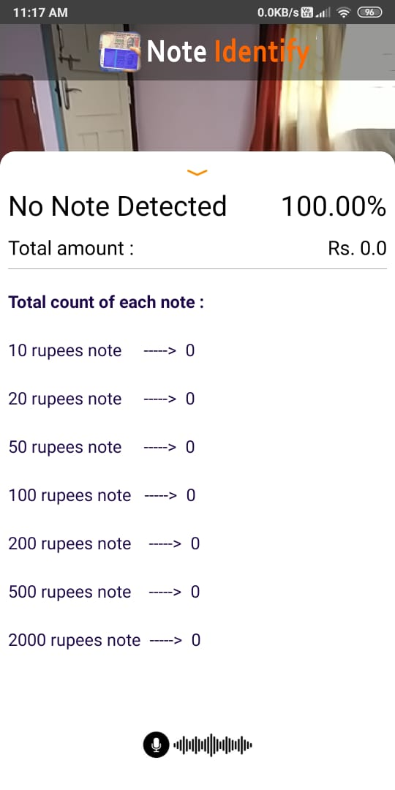

Slide 33

Application Demo

Slide 34
Conclusion
We showed our approach for currency recognition for visually impaired people
We described how we can easily build our own currency detector using deep learning and Tensorflow Lite
We showed how we can build, train deploy powerful deep learning model using small dataset
With no extra resources, we exported the model to tflite. This enables us to build innovative mobile apps, running on android

Slide 35
Technology Overview
All related deep learning code was run completely on the free tier provided by Anaconda navigator in its jupyter notebook environment without any extra paid resources
System specifications are :
Software Requirements :- Android Studio 4.1, Jupyter Notebook, Tensorflow
Hardware Requirements :- Operating System : Windows 10, RAM : 4GB and above, Processor: Intel® Core(TM) i3-8130U CPU, Processor Speed: 2.1 GHz, System type: 64-bit Operating System

Slide 36
Thank You!

